Slide 1
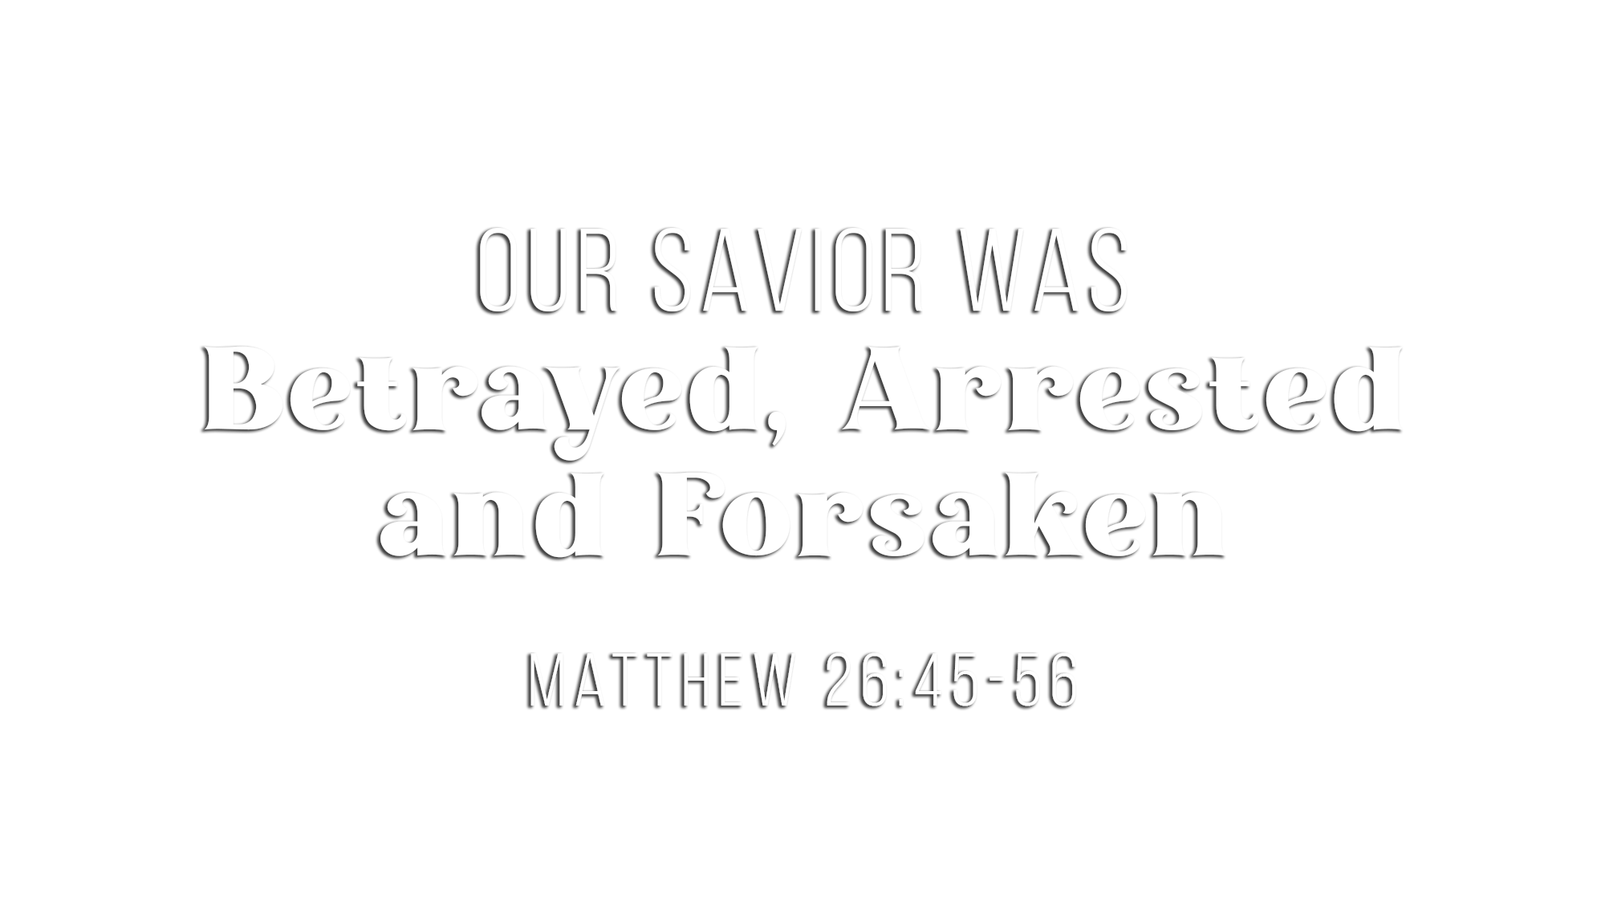

Slide 2
Prophesied –
Plotted –
Paltry –
Profitable –
Private –
Prearranged –
Pointed –
Personal –
Prelude –
Perdition –
Prompted –
Prophesied – In the O.T. (Psa. 41:9; Zech. 11:12-13) and by Jesus (John 13:18-30)
Plotted – Judas initiated the idea of his own free will (Matt. 26:14-16)
Paltry – Judas gave up his soul for the price of a dead, gored slave (Matt. 26:15)
Profitable – Judas and the chief priests agreed to a good deal for both (Luke 22:4-6)
Private – Judas sought a convenient time away from the multitude (Luke 22:6)
Prearranged – Judas gave the officers a signal of the kiss (Mark 14:44)
Pointed – Judas was the “guide” who “went before” them (Acts 1:16; Luke 22:47)
Personal – He was a “friend” and “one of the twelve” (Matt. 26:47, 50)
  He “knew the place” where Jesus would be—he had been there (John 18:2)
  He “drew near” to Jesus and kissed Him—affection of a friend (Luke 22:47-48)
Prelude – It was the first domino that led to all the subsequent evil (Matt. 26:45)
Perdition – It would have better if Judas “had never been born” (Mark 14:21)
Prompted – Judas had yielded himself to the devil’s influence (Lk. 22:3; Jn. 13:2, 27)

Slide 3
Prophesied –
People –
Predatory –
Prepared –
Perverse –
Procedure –
Preventive –
Permitted –
Preventable –
Protective –
Power of darkness –
Prophesied – Jesus knew it was coming (Mt. 26:54; Mk. 14:49; Zech. 13:7; Isa. 53:7)
People – A large crowd sent from Jewish leaders, plus chief priests, Jewish elders, temple police, plus a band of Roman soldiers and their commander
(Matt. 26:47; Luke 22:52; John 18:3, 12)
Predatory – They sought Jesus at night away from the crowds (Matt. 21:46; 26:55)
Prepared – Armed with swords, clubs, lanterns and torches (John 18:3; Matt. 26:47)
Perverse – They treated Jesus like an insurrectionist (Matt. 26:55)
Procedure – Grabbed Jesus, arrested Him and bound Him (Matt. 26:50; John 18:12)
Preventive – Peter attempted to thwart it with his sword (John 18:11; Matt. 26:51-52)
Permitted – Jesus cooperated and willingly submitted (John 18:2-11; Luke 22:51)
Preventable – Jesus could have called 12+ legions of angels (Matt. 26:52-54)
Protective – Jesus healed Malchus & interceded for His apostles (Lk. 22:51; Jn. 18:8-9)
Power of darkness – They are operating under the power of the devil (Luke 22:53)

Slide 4
Prophesied –
Predicted –
Parting –
Panic –
Prophesied –
Zechariah foretold that the Shepherd’s sheep would be scattered (Zech. 13:7)
Predicted –
Jesus Himself foretold that all of them would stumble
(Matt. 26:31)
Parting –
Every disciple separated himself from Jesus
(Matt. 26:56)
Panic –
They did not merely leave—they ran away and fled
(Mark 14:50)

Slide 5
Protect
Ponder
Prioritize
Prize
Personalize
Protect your heart from the progressive influence of the devil
Ponder the voluntary surrender of Jesus
Prioritize Christ’s purpose over your own plans, preferences and pursuits
Prize the faithfulness of Jesus when people fail you
Personalize the question:
What will I do with Jesus when following Him becomes costly?
  Judas chose profit. Enemies chose power.
  Peter chose his own plan. Disciples chose personal preservation.
  Jesus chose the Father’s purpose.
  What will I choose?

Slide 6
Believe Jesus is the Son of God – John 3:16
Repent of your sins and turn toward God – 2 Peter 3:9
Confess your faith in Jesus Christ – Romans 10:9
Be baptized into Christ – 1 Peter 3:21
  God will forgive all of your sins – Acts 2:38
  God will add you to His church – Acts 2:47
  God will enroll you in heaven – Hebrews 12:23
Live faithfully to the Lord – Revelation 2:10

