Slide 1
Maximizing
Your Encouragement Potential
Bible Examples Through the Life of Barnabas
October 4 through December 9
2026

Slide 2
Where is their Focus?
What do you see in this image?
  weak or sick
  leper
  lame
  rich
  poor
  distraught
  Old
  Young
  And…the one who isn’t interested
Which one Needs Encouragement?

Slide 3
“Everyone needs encouragement, and every Christian has the ability to give it. Using Barnabas, the “Son of Encouragement,” as a Biblical model, this class will explore practical ways to strengthen others through words, actions, presence and service. The goal is to help each participant recognize and develop the encouragement potential God has already given them, then put it to work in everyday relationships and congregational life.”

Slide 4
Do you recall being encouraged?
Aa child
As a Teenager
As a Young Adult
As a Mother/Father
As a Grandmother/Grandfather
In school, sports, work, recreation
After disappointments, setbacks, failures, tragedies
In your spiritual life by preachers, elders, deacons, members, family/friends, examples of others.
By studying your Bible?
Remember the impact on you by those who encouraged you.

Slide 5
Today’s Outline
Source of Encouragement
  The Bible- not psychology books or YouTube or social media
  Created in the Image of God and Jesus is the earthly Image of God
Who IS Barnabas –Part I
  Early Church in Jerusalem – Acts 4:32-37
  Embraced Saul Acts 9:23-31
  Trusted by Apostles and Sought out Saul-Acts 11:19-30

Slide 6
Sources of Encouragement

Slide 7
In the Beginning
Gen Genesis 1:26 Then God said, "Let Us make man in Our image, according to Our likeness; let them have dominion over the fish of the sea, over the birds of the air, and over the cattle, over all the earth and over every creeping thing that creeps on the earth." 27 So God created man in His own image; in the image of God He created him; male and female He created them.
Gen 2:18 And the LORD God said, "It is not good that man should be alone; I will make him a helper comparable to him."
We are made in the Image of God
We should be Confident in God’s overwatch of our souls and minds
He gives us His word to strengthen and encourage us.
He will not ever fail us-only we can do that

Slide 8
Throughout the Old Testament
Moses – Deu 1:38, 3:28 encourages Joshua
Hezekiah – 2 Chr 18:12 encourages Levites
Johnathan-1 Sam 23:16
David-1 Sam 30:6Psalmist 119:28 strengthen me according to Your Word
Many Others
  Neamiah
  Deborah
  Elijah
  Elisha
WE have the encouragement of the Patriarchs and those who stood firm for God’s righteousness
So many examples of Encouragement throughout the Old Testament

Slide 9
Jesus’ Examples
His Compassion for all
Lost, poor, sick, blind, lepers, suffering demons, death of loved ones, plight of the downtrodden, the weary….
And His compassion was manifested by action;
He Healed the sick, gave sight to the blind, provided for the poor, comforted the weary and suffering, raised the dead, cast out demons.
Mt 14:14; 20:34; Mk 9:22,Lk 7:13,
Jesus’ example in the NT can give us strength every moment
Prepare ourselves in His words

Slide 10
Throughout the NT
Rom 14:9 Therefore let us pursue the things which make for peace and the things by which one may edify another.
Eph 4:12 ..for the edifying of the body of Christ,
1 Thes 5:11 Therefore comfort each other and edify one another, just as you also are doing
The New Testament is full of encouraging examples that can build our faith
May we be an encourager every day of our life!

Slide 11
Barnabas

Slide 12
Barnabas
Who IS he?
Where/When did he come into the NT?
What IS his character?
Where did Barnabus get his traits his character?

Slide 13
Who IS Barnabas?
Act 4:32-37
32 Now the multitude of those who believed were of one heart and one soul; neither did anyone say that any of the things he possessed was his own, but they had all things in common. 33 And with great power the apostles gave witness to the resurrection of the Lord Jesus. And great grace was upon them all. 34 Nor was there anyone among them who lacked; for all who were possessors of lands or houses sold them, and brought the proceeds of the things that were sold, 35 and laid them at the apostles' feet; and they distributed to each as anyone had need. 36 And Joses, who was also named Barnabas by the apostles (which is translated Son of Encouragement), a Levite of the country of Cyprus, 37 having land, sold it, and brought the money and laid it at the apostles' feet.

Slide 14
Acts 4:32-37 Barnabas First Mentioned
Was He one of those who believed at Pentecost?
All did not consider their possessions as their own
They had ALL things in common
None of them lacked
They sold their possessions and laid them at the apostles’ feet
Joses was his name
The apostles gave him the name Barnabas
Translated –Son of encouragement
A Levite
Of the country of Cyprus
This was the first days/weeks after Pentecost
Why did the apostles give Joses the name Barnabas?
His Actions?
Note he was a Levite!
He was from Cyprus
Apostles named him Barnabas
He gave of his property

Slide 15
Acts 9:23-31 Embraced Paul
Jews plotted to kill Saul in Damascus
Disciples took Saul to Jerusalem
Apostles and Disciples were afraid
Barnabas took him and broght him to the Apostles
Declared Sauls conversion and Preaching
Character of Barnabas
  Bold-Took Saul to Apostles
  Vocal-Stood up for Saul the persecutor of Christians
  Convinced Apostles to accept Saul
  Churches at Tarsus, Galilee and Samaria were edified
Because Barnabus stood up

Slide 16
Acts 11:19-30 Encouraged church at Antioch
Some Disciples fled Jerusalem
Preached the Lord Jesus in Phoenicia, Cyprus, and Antioch
Preached to Hellenists in Antioch
Great number believed and turned to the Lord
Church of Jerusalem sent Barnabas to Antioch
Barnabas encouraged the church
Character of Barnabas
Trusted by apostles
Boldly taught the truth in face of persecution
Encouraged church at Antioch
A good Man Full of the Holy Spirit and Faith
Left to seek Saul
Spent 1 year in Antioch with Saul

Slide 17
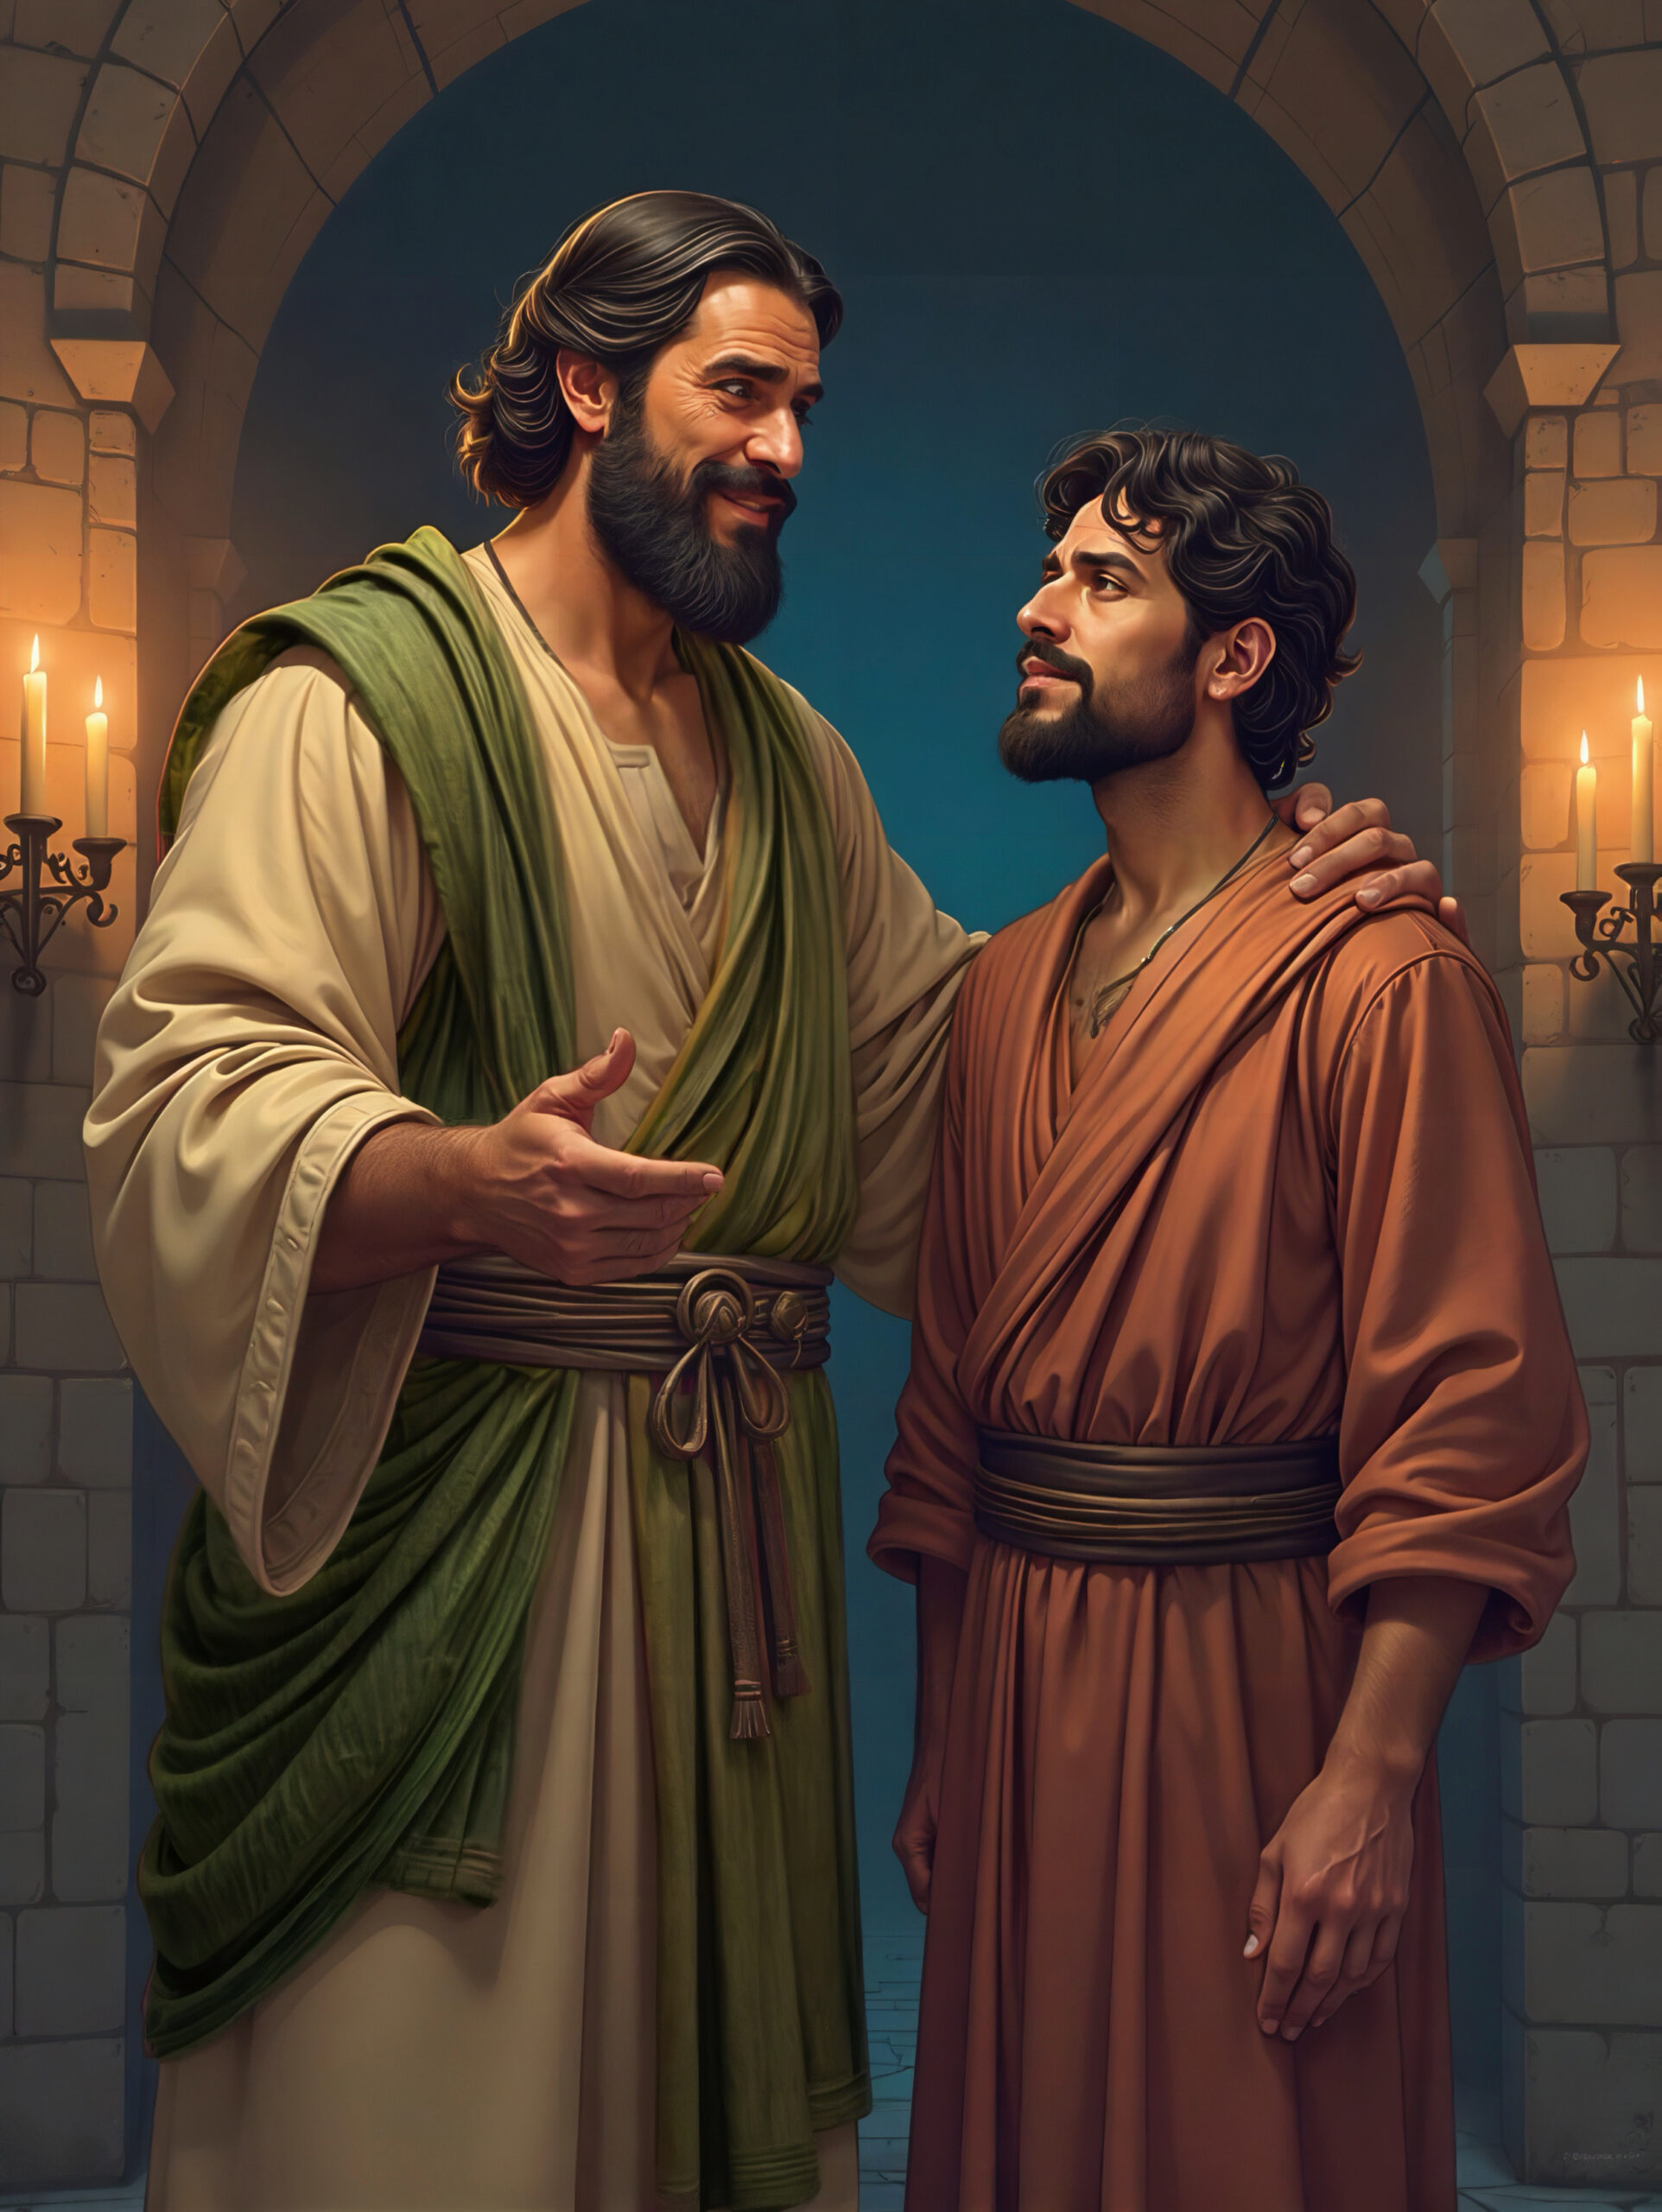
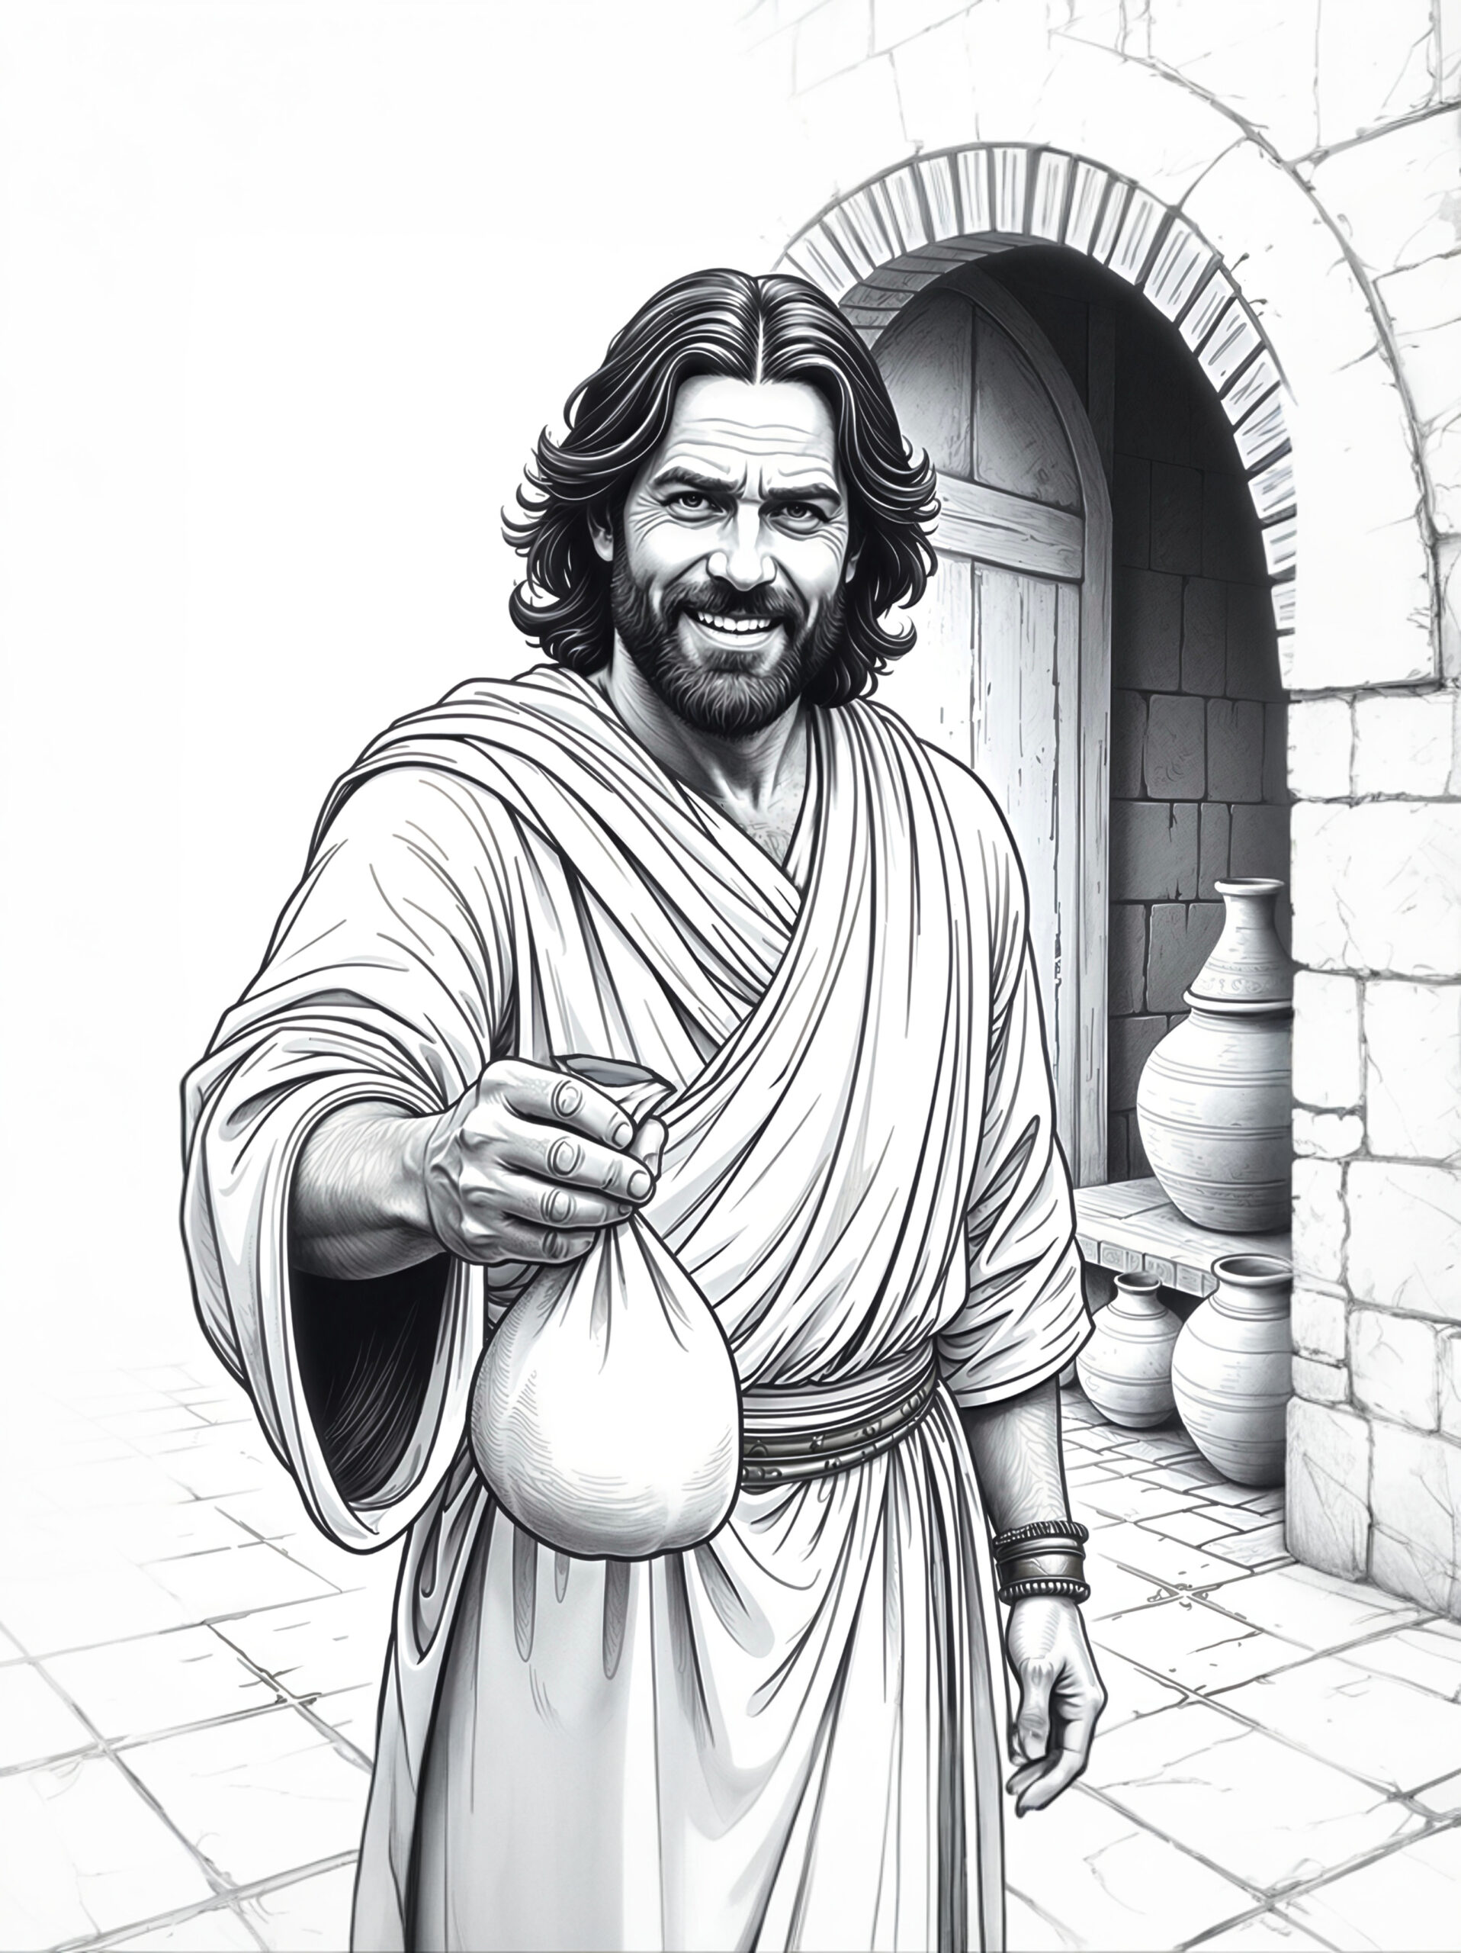
In case you’re Wondering what Barnabas looks like?
Source: Apologetics Press
Discovery Bible Cards

Slide 18
Use It or Loose It
Use your concordance or Bible app and
Find the passages that mention Barnabas
There are 15 passages
2. Read the passages carefully
Highlight Actions/VERBS associated with Barnabas
Understand the context – before and after
Write down the traits or characteristics of Barnabus
Encourage Someone
EVERY Day This Week

