Slide 1
Maximizing
Your Encouragement Potential
Bible Examples Through the Life of Barnabas
The MIND of an Encourager
Lesson 4 October 25, 2026

Slide 2

We are studying about Encouragement using the example of Barnabas
Sources of Encouragement
Our Motivation to Encourage
The Power of Encouragement
The Mind of an Encourager

Slide 3
The Mind of an Encourager
What is the CHARACTER of a person?
The inward nature that shapes outward living
Where does the CHARACTER of a person reside?
In the Heart (Mind) of a person

Slide 4
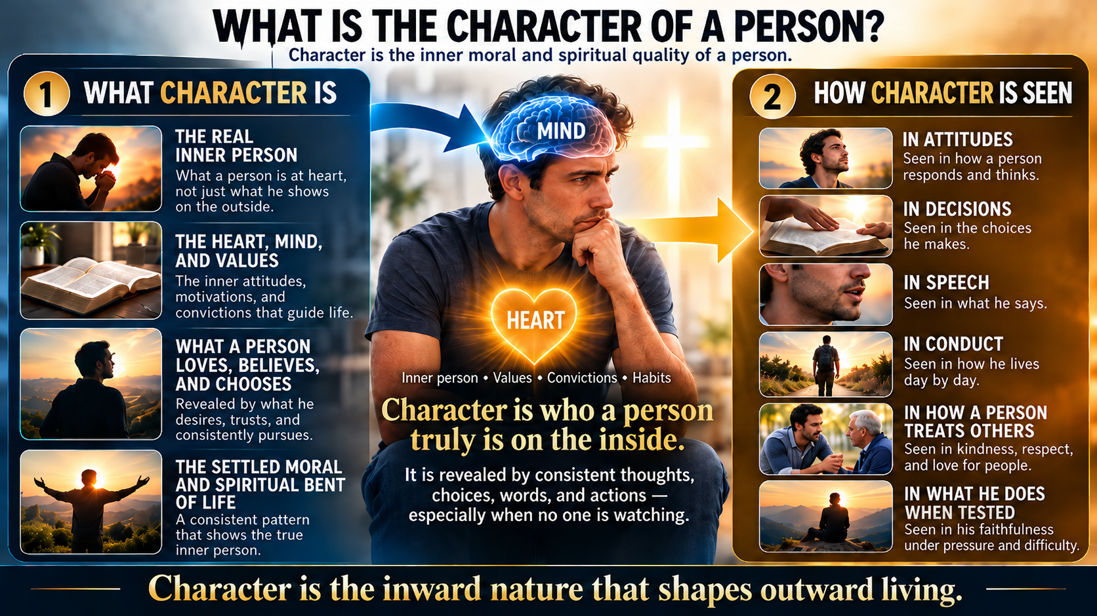

Slide 5
What Shapes the Mind
Jesus taught the Pharisees Scribes and Disciples a powerful lesson
Mark 7:1-13
Let’s Read together!

Slide 6
Mrk 7:1-13
1 Then the Pharisees and some of the scribes came together to Him, having come from Jerusalem. 2 Now when they saw some of His disciples eat bread with defiled, that is, with unwashed hands, they found fault. 3 For the Pharisees and all the Jews do not eat unless they wash their hands in a special way, holding the tradition of the elders. 4 When they come from the marketplace, they do not eat unless they wash. And there are many other things which they have received and hold, like the washing of cups, pitchers, copper vessels, and couches.
5 Then the Pharisees and scribes asked Him, "Why do Your disciples not walk according to the tradition of the elders, but eat bread with unwashed hands?"
6 He answered and said to them, "Well did Isaiah prophesy of you hypocrites, as it is written: 'THIS PEOPLE HONORS ME WITH THEIR LIPS, BUT THEIR HEART IS FAR FROM ME. 7 AND IN VAIN THEY WORSHIP ME, TEACHING AS DOCTRINES THE COMMANDMENTS OF MEN.' 8 For laying aside the commandment of God, you hold the tradition of men—the washing of pitchers and cups, and many other such things you do."
9 He said to them, "All too well you reject the commandment of God, that you may keep your tradition. 10 For Moses said, 'HONOR YOUR FATHER AND YOUR MOTHER'; and, 'HE WHO CURSES FATHER OR MOTHER, LET HIM BE PUT TO DEATH.' 11 But you say, 'If a man says to his father or mother, "Whatever profit you might have received from me is Corban"—' (that is, a gift to God), 12 then you no longer let him do anything for his father or his mother, 13 making the word of God of no effect through your tradition which you have handed down. And many such things you do."

Slide 7
Mrk 7:14-23
14 When He had called all the multitude to Himself, He said to them, "Hear Me, everyone, and understand: 15 There is nothing that enters a man from outside which can defile him; but the things which come out of him, those are the things that defile a man. 16 If anyone has ears to hear, let him hear!"
17 When He had entered a house away from the crowd, His disciples asked Him concerning the parable. 18 So He said to them, "Are you thus without understanding also? Do you not perceive that whatever enters a man from outside cannot defile him, 19 because it does not enter his heart but his stomach, and is eliminated, thus purifying all foods?" 20 And He said, "What comes out of a man, that defiles a man. 21 For from within, out of the heart of men, proceed evil thoughts, adulteries, fornications, murders, 22 thefts, covetousness, wickedness, deceit, lewdness, an evil eye, blasphemy, pride, foolishness. 23 All these evil things come from within and defile a man."

Slide 8
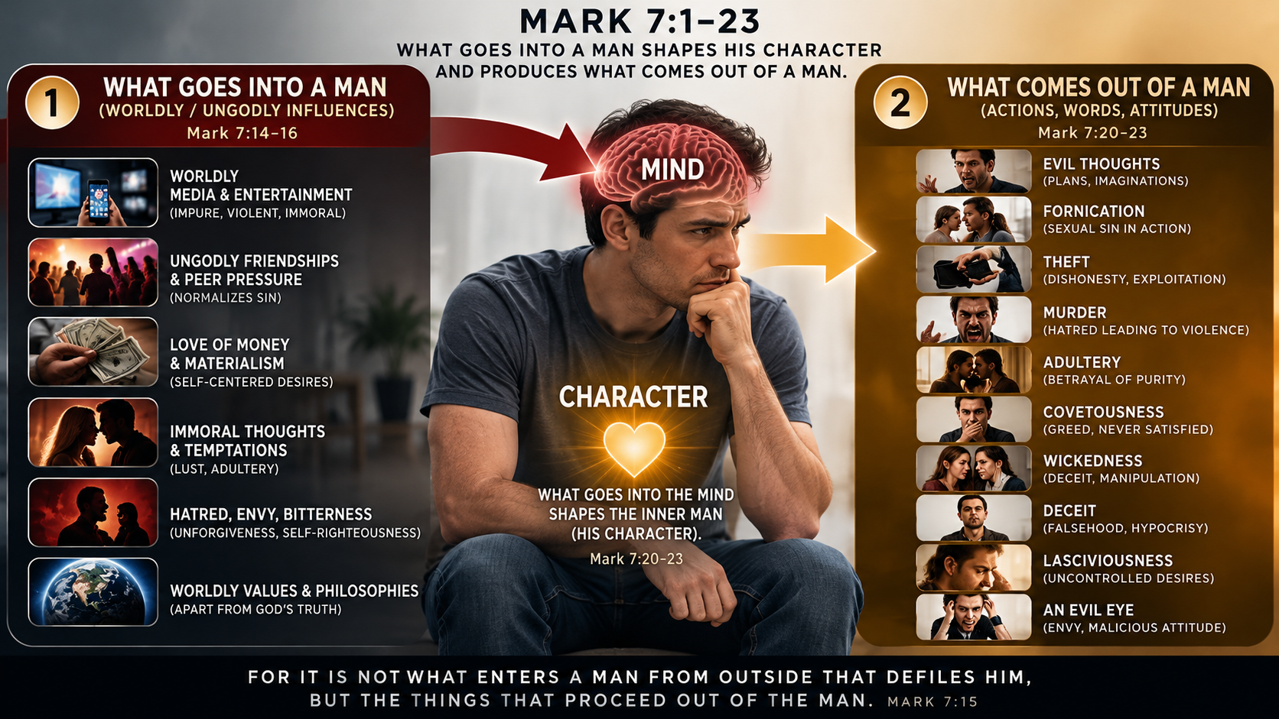

Slide 9
23 All these evil things come from within and defile a man."
It is the things we let into our mind that shape our character
What we Hear See Touch and Consume
What we do is a result of decisions we make
Righteousness or Sin
We are created in God’s image and not animals who have no sense of right or wrong.
We choose to speak and act based on what is inside our Mind

Slide 10
So what DO we PUT into our Mind?
WE all must be Transformed from our worldly mind into our spiritual mind
How?

Slide 11
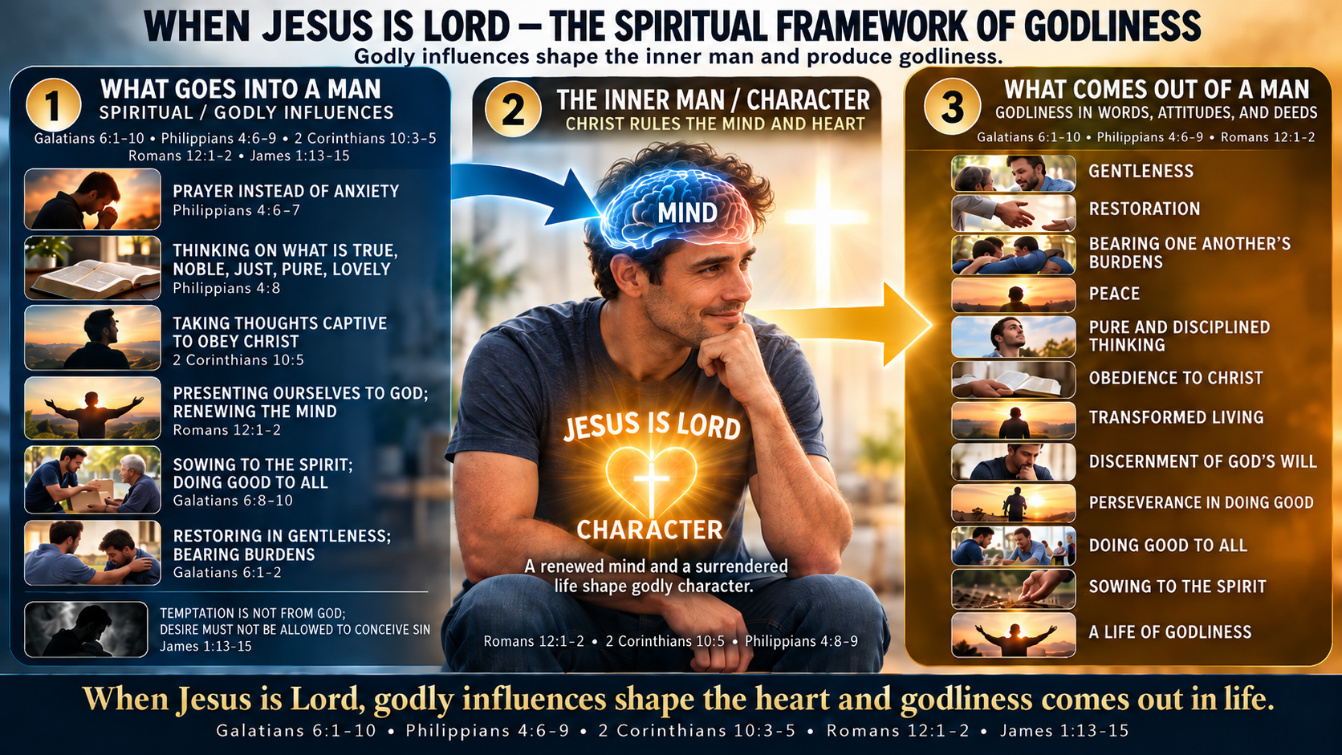

Slide 12
THE MIND OF A BIBLICAL ENCOURAGER
15 characteristics of a Christ-directed, spiritually disciplined mind
1. Christ-centered
2 Corinthians 10:5
6. Compassionate
Galatians 6:2
11. Discerning
James 1:13–15
2. Spiritually minded
Galatians 6:8
7. Others-focused
Galatians 6:10
12. Self-controlled
2 Corinthians 10:5
3. Renewed
Romans 12:2
8. Prayerful
Philippians 4:6
13. Patient & persevering
Galatians 6:9
4. Humble
Galatians 6:1, 3
9. Peaceful
Philippians 4:7
14. Self-examining
Galatians 6:4–5
5. Gentle
Galatians 6:1
10. Pure
Philippians 4:8
15. Action-oriented
Philippians 4:9; Galatians 6:10
GODLY THOUGHTS → RENEWED MIND → CHRISTLIKE CHARACTER → ENCOURAGING DEEDS

Slide 13
This week
GO!
Let the word of God dwell in you Richly!
Col 3:16 Let the word of Christ dwell in you richly in all wisdom, teaching and admonishing one another in psalms and hymns and spiritual songs, singing with grace in your hearts to the Lord.
17 And whatever you do in word or deed, do all in the name of the Lord Jesus, giving thanks to God the Father through Him.

